Slide 1

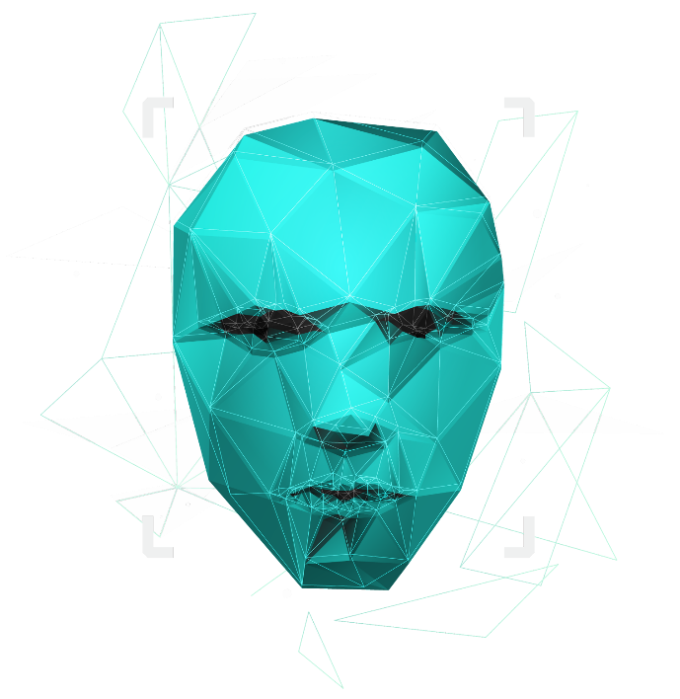
HELLO ! We are Group-18
With Our project AI AS A SERVICE (AlaaS)

Slide 2



AI AS A SERVICE (AlaaS)

Slide 3






MEET OUR TEAM
SOUMESH SANTRA (Research)
12019004009107
Department of Computer Applications
UEM, Kolkata
ARINDIP DUTTA (Documentation)
12019004009098
Department of Computer Applications
UEM, Kolkata
RAJA SAHA (Sides)
12019004009099
Department of Computer Applications
UEM, Kolkata
TANAY MONDAL (Documentation)
12019004009043
Department of Computer Applications
UEM, Kolkata
RISHAV KHAMRUI (Research)
12019004009057
Department of Computer Applications
UEM, Kolkata

Slide 4
ACKNOWLEDGMENT
I would like to thank my teacher Somnath Banerjee who gave me this opportunity to work on this project. I got to learn a lot from this project about the impact of AI on the business industry. I would also like to thank our HOD Koustuv Bhattacharya.
At last, I would like to extend my heartfelt thanks to my fellow team members because without teamwork this project would not have been successful.

Slide 5
TABLE OF CONTENTS
Understanding AI
The growth of AIaaS
Future scope
Disadvantages
Introduction of our project
How does AI works
Advantages
Examples
Conclusion

Slide 6

INTRODUCTION OF OUR PROJECT
AI as a Service is a term used to describe a third party that provides advanced AI functionalities to companies upon a one-time payment or subscription fee. It’s not an understatement to say that it’s a game-changer for many small-to-medium businesses. AI as a service allows individuals and companies to experiment with AI for various purposes without large initial investment and with lower risk.
The concept of everything as a service refers to any software that can be called upon across a network because it relies on cloud computing. In most cases, the software is available off the shelf. You buy it from a third-party vendor, make a few tweaks, and begin using it nearly immediately, even if it hasn’t been totally customized to your system.

Slide 7
UNDERSTANDING AI
We hear it repeated over and over: artificial intelligence is a way to get machines to do the same kind of work that human brains can accomplish. This definition is the subject of significant debate, with technology experts arguing that comparing machines to human brains is the wrong paradigm to use. It may promote fear that humans can be taken over by machines.

Slide 8
HOW DOES AI WORK
Creates an interpretable cause & effect relationship from that data.
The majority of AI makes use of algorithms. Algorithms are defined as a set of rules or a process that is followed, typically by a computer, to calculate or solve a problem
Takes a set of data.
Uses that data to build a machine learning model.

Slide 9
THE GROWTH OF AIaaS
For companies that can’t or are unwilling to build their clouds and build, test, and utilize their artificial intelligence systems, AIaaS is the solution. The biggest draw is the opportunity to take advantage of data insights without needing the massive up-front investment in talent and resources.
28% of enterprises are experimenting with AI/ML.
46% of enterprises are experimenting or plan to experiment with AI/ML.
AI/ML in the field companies is most experimenting in.

Slide 10
ADVANTAGES
Scalability
Usability
Flexibility
Lower cost

Slide 11
DISADVANTAGES
Data governance
Lack of transparency
Reliance
Security

Slide 12
01
Chatbots
02
Agent assist
03
Self-service
Robotic process automation
04
EXAMPLES
05
Machine learning
06
Natural language processing
07
IVR automation
Sentiment and advanced analytics
08

Slide 13
FUTURE SCOPE
AIaaS has plenty of benefits that bring early adapters to the table as a rapidly growing field. But, its drawbacks mean there’s plenty of room for improvement.
While there may be bumps in the road while developing AIaaS, it’s likely to be as important as other “as a service” offerings. Taking these valuable services out of the hands of the few means that many more organizations can harness the power of AI and ML.

Slide 14

CONCLUSION
AI PaaS empowers businesses with a variety of helpful AI features and capabilities, which in turn can accelerate and simplify the development of intelligent applications. Such platforms also provide collaboration opportunities for developers, data engineers, and business analysts, which is important for the growth and evolution of artificial intelligence technology.
However, working with AI PaaS can hide some pitfalls like lack of customization opportunities and concerns regarding security compliance. So, make sure to research how AI providers handle data and what customization opportunities they offer before choosing one to work with.

Slide 15
AI as a Service: Serverless machine learning with AWS by Peter Elger & Eóin Shanaghy
Book :-
BIBLIOGRAPHY
Understanding the AIaas:
https://bit.ly/3k5BD3r
How AIaas Works:
https://bit.ly/37FR93t
AIaas Implementation:
https://bit.ly/38kpllf
Other Useful Details about AIaas:
https://bit.ly/36Ex9h1
Links:-

Slide 16

THANKS!
- Presented By Group-18

